Slide 1
DUAL DEGREE PROJECT - 1
KUNAL RANDAD
20D070049
Graph Coloring with Implementation of Oscillatory Neural Network

Slide 2
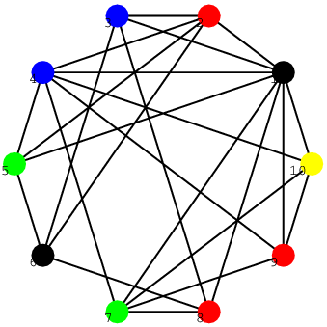
Graph Coloring
Coloring the vertices of a graph in such a way that no two adjacent vertices have the same color (aka vertex coloring problem)
Chromatic Number = Minimum number of colors required
Finding Chromatic Number is NP-Complete
Applications: Scheduling, Register Allocation, Routing, etc.

Slide 3
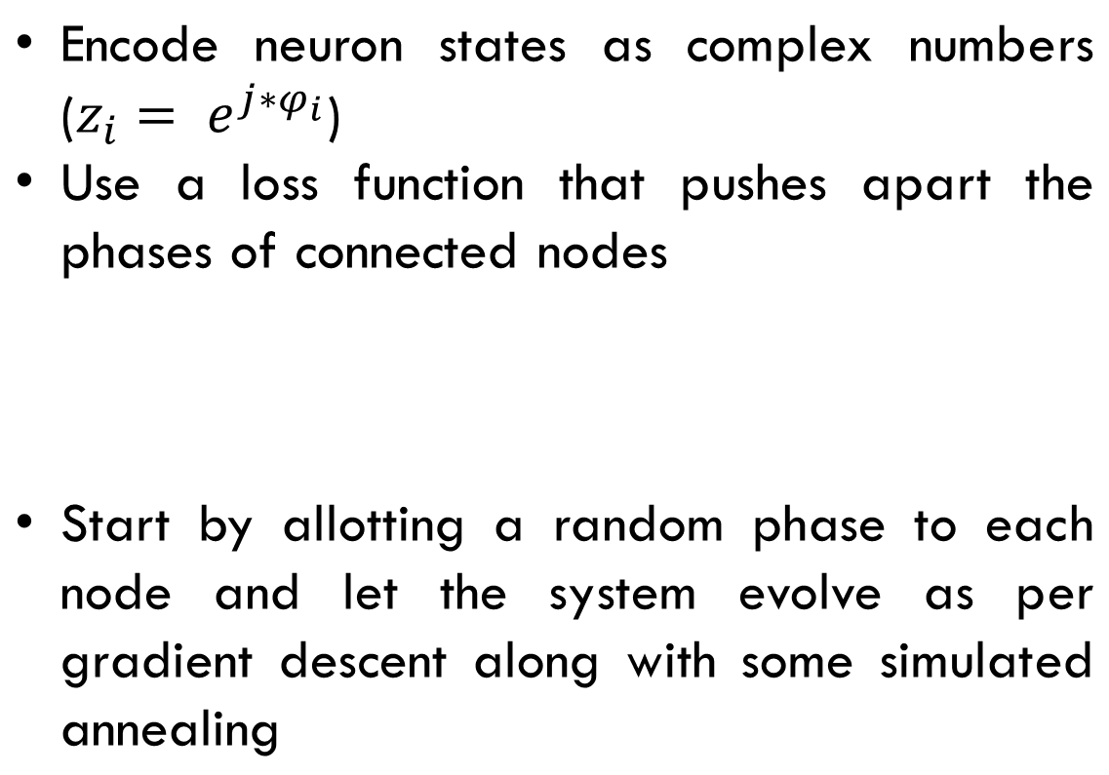
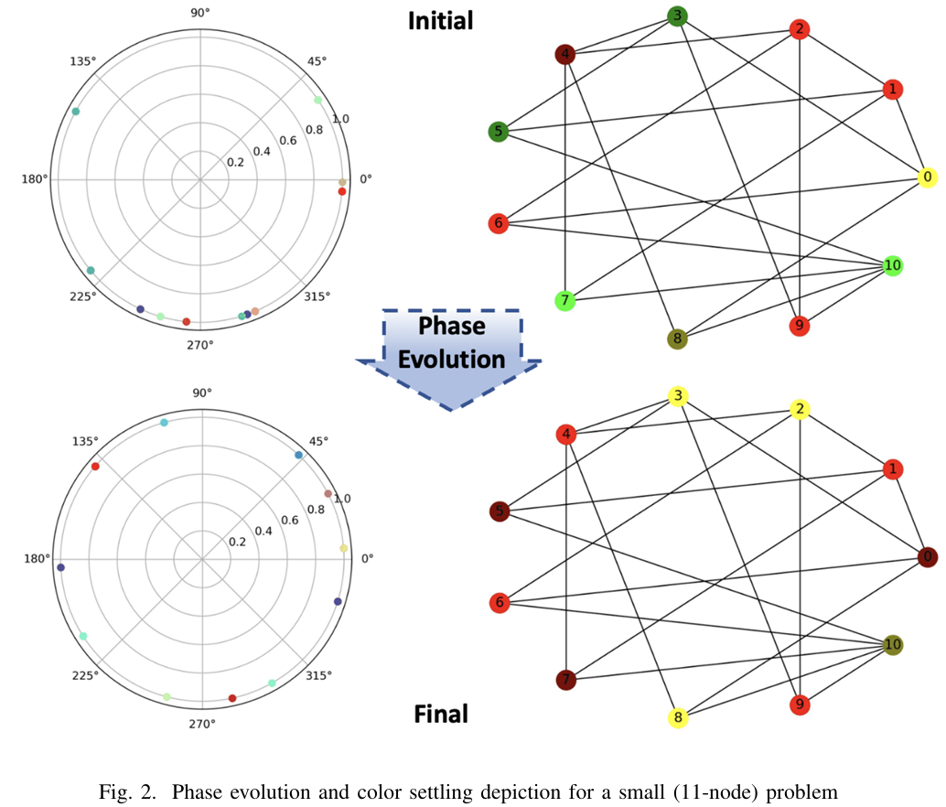
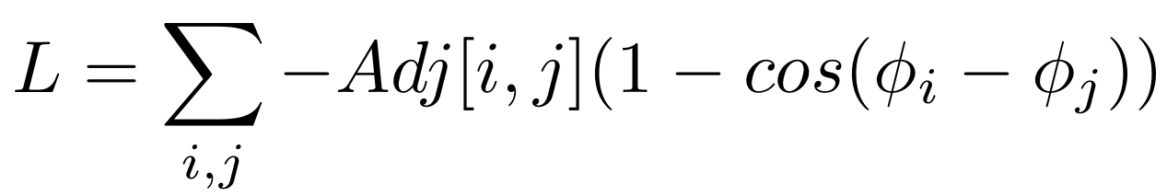
Technical approach and implementation of oscillatory neural network

Slide 4
Technical approach and Results
The equations are transformed suitably for implementation in hardware
After settling, the phases of adjacent nodes are maximally separated, allowing colors to be assigned through a polynomial time algorithm
Graph | huck | myciel3 | myciel4 | myciel5 | myciel6 | david | queen55 | queen66 | queen77
Nodes | 74 | 11 | 20 | 47 | 95 | 87 | 25 | 36 | 49
Berlaz Heuristic | 11 | 4 | 5 | 6 | 7 | 11 | 7 | 10 | 12
Coupled Oscillators | 12 | 4 | 5 | 6 | 8 | 13 | 6 | 12 | 12
Prev Work | 12 | 4 | 5 | 6 | 9 | 13 | 6 | 12 | 15

Slide 5
observations and inference
Performs well on small graphs
Gives sub-optimal results as graphs get larger, hence not directly scalable
Need to use some kind of divide and conquer approach

Slide 6
Divide and conquer
We can divide large graphs into two sub-graphs
Each subgraph can be colored separately with different colors
As both sub-graphs are given unique set of colors, merging back directly will not cause any problem
However, this is sub-optimal merging, instead, colors in sub-graph which don’t have any edge joining them can be merged. Currently done with a brute force approach

Slide 7
Division methodology
It would be beneficial to use techniques that can be easily implemented in Hardware
Graph division using following methodologies were explored
Random Cut
Max Cut : This involves cutting the graph into two sub-graphs such that there are maximum number of edges joining two sub-graphs. Following two algorithms were used for this:
  Modified One Exchange Approximation
  Goemans-Williamson Approximation Algorithm

Slide 8
Modified one exchange approximation (MOE)
This gives an approximate solution
It is a greedy strategy with following steps:
  Make two sets, set1 and set2
  Add all the vertices in set1 and keep set2 empty
  Iterate over all the vertices and find the vertices that lead to maximum increase in cut value
  Break ties randomly if they arrive and select one vertex
  Exchange the set of selected vertex
  Repeat steps 3 to 5 while at-least one of this is true
    Maximum Increase > 0
    Maximum Increase = 0 and there exists an exchange which reduces the size difference of two sets
There was no known guarantee for the expected results. Hence, needed another method to benchmark the results

Slide 9
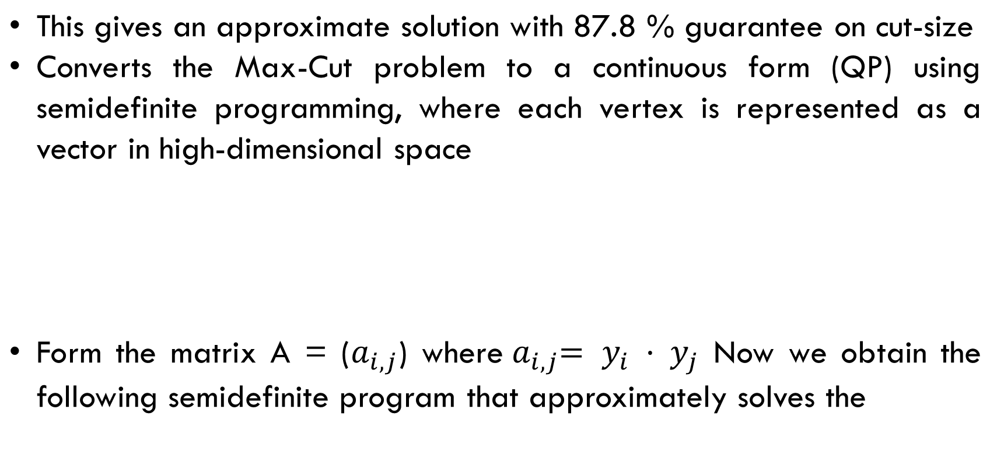
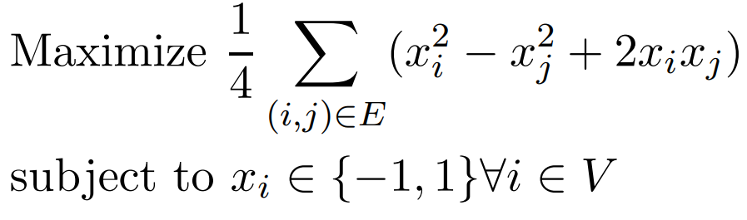
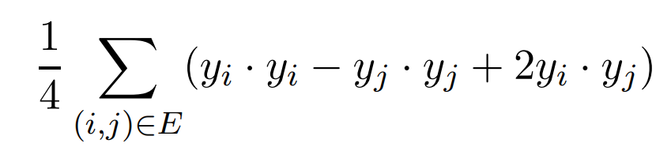
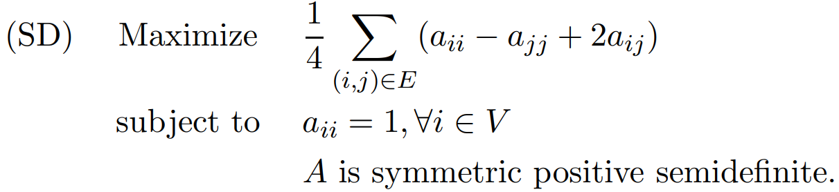
Goemans-Williamson approximation algorithm

Slide 10
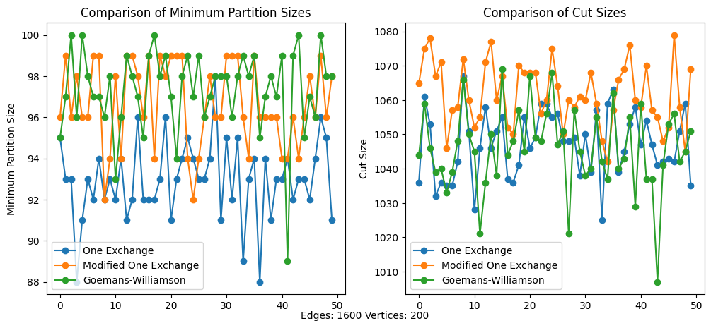
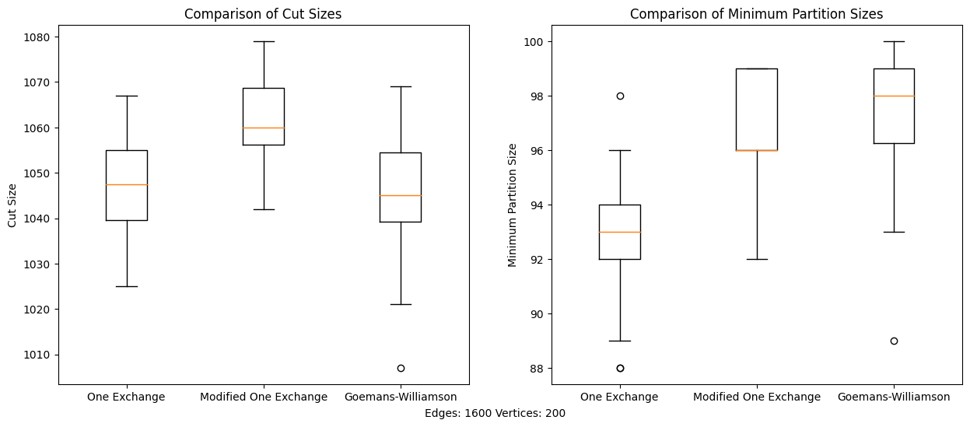
Comparing the two algorithms

Slide 11
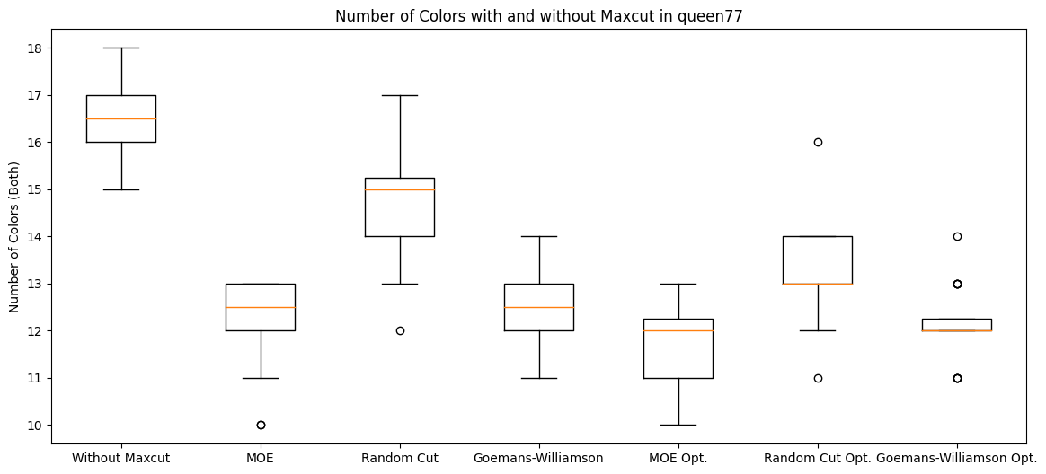
RESULTS

Slide 12
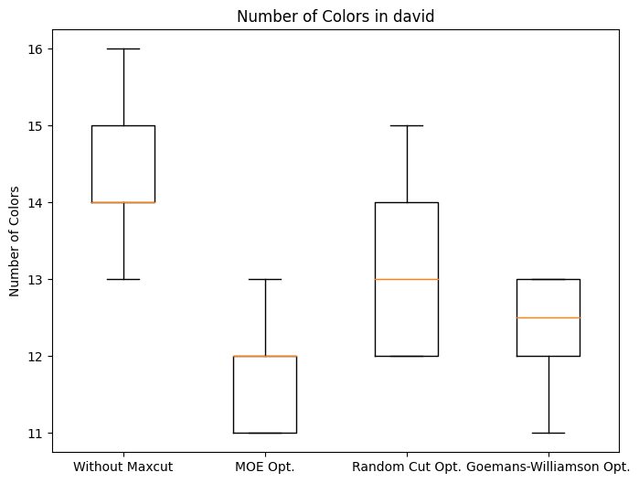
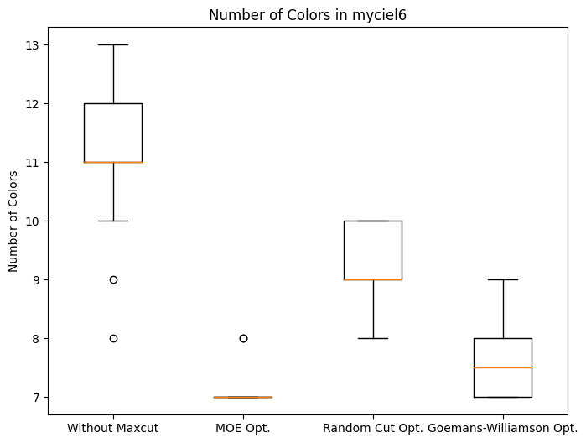
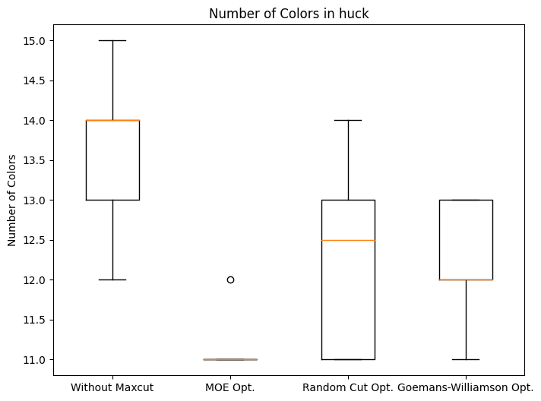
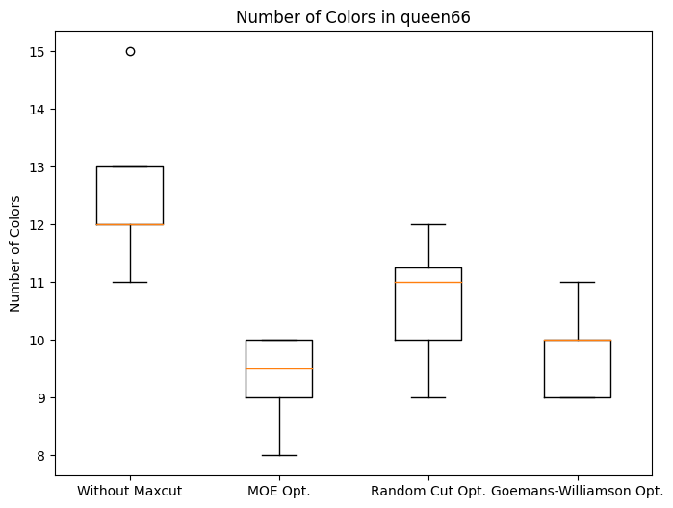
RESULTS

Slide 13
RESULTS
Graph | Nodes | Berlaz Heuristic | Coupled Oscillators | Prev Work | Prev Work Re-run Minimum | MOE Minimum | Random Cut Minimum | Goemans-Williamson Minimum
huck | 74 | 11 | 12 | 12 | 12 | 11 | 11 | 11
myciel3 | 11 | 4 | 4 | 4 | 4 | 4 | 4 | 4
myciel4 | 20 | 5 | 5 | 5 | 5 | 5 | 5 | 5
myciel5 | 47 | 6 | 6 | 6 | 6 | 6 | 6 | 6
myciel6 | 95 | 7 | 8 | 9 | 8 | 7 | 8 | 7
david | 87 | 11 | 13 | 13 | 13 | 11 | 12 | 11
queen55 | 25 | 7 | 6 | 6 | 7 | 5 | 6 | 5
queen66 | 36 | 10 | 12 | 12 | 11 | 8 | 9 | 9
queen77 | 49 | 12 | 12 | 15 | 15 | 10 | 11 | 11
Minimum taken over 20 runs

Slide 14
key insights and hypotheses
Although standard one-exchange method gives similar results as Goemans Williamson approximation in terms of cut-size, the difference in sizes of sub-graphs was high
Hence the modification was made so that exchange takes place even if it does not increase cut-size. Trivially, this also leads to better approximations
Random cut give better results than no-cut given that we merge optimally in cases where graph size is large enough
Max-Cut approximations give better results than previous work as well as random cuts in all the graphs, even without coloring optimally

Slide 15
key insights and hypotheses
Merging the two sub-graphs
Once sub-graphs are colored individually, merging can be treated as another graph coloring problem, but we treat each individual color as a vertex and an edge joins two vertices if there exists a edge joining any pair of vertices with corresponding colors in the original graph
For example, in the graph shown above, yellow can be merged with black, as there are no edges joining them in between the sub-graphs

Slide 16
key insights and hypotheses
Here is a simple example to understand why max-cut tends to give better coloring
Set 1
Set 2
X
We have two sets, Set 1 and Set 2 and we want to assign vertex X to one of them
In the case above, it is better to assign vertex X to set where it has less connections. This will cause higher increase in the cut size
In general, when we have to assign vertex X to one of the sets, the chances that it will cause an increase in total number of colors is higher in the set where it has more connections because more connections are likely to increase the number of colors already taken and if all colors are taken, a new color must be added for X

Slide 17
REferences
Neuromorphic Implementation of Oscillatory Neural Networks for Graph Coloring. Anmol Biswas, Sumedh R. Risbud and Udayan Ganguly
CS 810: Introduction to Complexity Theory 04/03/03 Lecture 20: Goemans-Williamson MAXCUT Approximation Algorithm Instructor: Jin-Yi Cai 1 Overview Scribe: Christopher Hudzik, Sarah Knoop

Slide 18
_{THANK}
_{YOU}

Slide 19
RESULTS
Graph | Nodes | Berlaz Heuristic | Coupled Oscillators | Prev Work | Average | Minimum | MOE Average | MOE Minimum | Random Cut Average | Random Cut Minimum | Goemans-Williamson Average | Goemans-Williamson Minimum
huck | 74 | 11 | 12 | 12 | 13.7 | 12 | 11.05 | 11 | 12.25 | 11 | 12.15 | 11
myciel3 | 11 | 4 | 4 | 4 | 4 | 4 | 4 | 4 | 4.15 | 4 | 4 | 4
myciel4 | 20 | 5 | 5 | 5 | 5 | 5 | 5.25 | 5 | 5.6 | 5 | 5 | 5
myciel5 | 47 | 6 | 6 | 6 | 6.75 | 6 | 6 | 6 | 6.95 | 6 | 6.1 | 6
myciel6 | 95 | 7 | 8 | 9 | 11.15 | 8 | 7.1 | 7 | 9.25 | 8 | 7.65 | 7
david | 87 | 11 | 13 | 13 | 14.45 | 13 | 11.7 | 11 | 13.05 | 12 | 12.35 | 11
queen55 | 25 | 7 | 6 | 6 | 8.7 | 7 | 7.05 | 5 | 8.15 | 6 | 7.25 | 5
queen66 | 36 | 10 | 12 | 12 | 12.2 | 11 | 9.4 | 8 | 10.85 | 9 | 9.85 | 9
queen77 | 49 | 12 | 12 | 15 | 16.55 | 15 | 11.75 | 10 | 13.25 | 11 | 12.1 | 11

Slide 20
RESULTS
Graph | Nodes | Berlaz Heuristic | Coupled Oscillators | Prev Work | Prev Work Average | MOE Average | Random Cut Average | Goemans-Williamson Average
huck | 74 | 11 | 12 | 12 | 13.7 | 11.05 | 12.25 | 12.15
myciel3 | 11 | 4 | 4 | 4 | 4 | 4 | 4.15 | 4
myciel4 | 20 | 5 | 5 | 5 | 5 | 5.25 | 5.6 | 5
myciel5 | 47 | 6 | 6 | 6 | 6.75 | 6 | 6.95 | 6.1
myciel6 | 95 | 7 | 8 | 9 | 11.15 | 7.1 | 9.25 | 7.65
david | 87 | 11 | 13 | 13 | 14.45 | 11.7 | 13.05 | 12.35
queen55 | 25 | 7 | 6 | 6 | 8.7 | 7.05 | 8.15 | 7.25
queen66 | 36 | 10 | 12 | 12 | 12.2 | 9.4 | 10.85 | 9.85
queen77 | 49 | 12 | 12 | 15 | 16.55 | 11.75 | 13.25 | 12.1

Slide 21
key insights and hypotheses
Here is a simple example to understand why max-cut tends to give better coloring
Set 1
Set 2
X
We have two sets, Set 1 and Set 2 and we want to assign vertex X to one of them
If X is assigned to Set 1, it will be assigned new color and overall, total number of colors assigned will increase. This increases cut-size by 1
If X is assigned to Set 2, it can be assigned Yellow or Purple and total number of colors assigned will remain same. This increases the cut size by 3
Thus, it makes sense to assign vertex X to set where it has less connections. This is same as placing X in set where the cut-size increases by maximum

